Slide 1

Group II
EMPLOYEE
ATTRITION
ANALYTICS
JEFFREY Cruz-GARCIA
Olesya Gaeva
Aditi garg
BRANDON chacon-MATA
SUSAN ESPINOSA
VIGNESHWAR CHERIATH
Notes:
Aditi - INTRO

Slide 2

Agenda
Introduction: Project Execution Steps
- How did we source the data?
- What in the topic piqued our interest?
- Tools
Deep Dive into the analytics
( visualizations and explanations )
Conclusion
Questions
Notes:
TBD - Olesya

Slide 3
Introduction
Employee Attrition Analytics (EAA) is the process of analyzing data to determine the causes of employee turnover in an organization. EAA allows organizations to identify potential risk areas or areas for improvement, such as high turnover rates in specific departments or job roles.
By addressing these issues, businesses can improve employee morale, lower turnover costs, and ultimately build a more successful and sustainable business.
Why this matters: Understanding what kinds of employees leave the company helps to retain talent and prevent burnout. This saves the costs of training new hires and invests in building long-term expertise in the company.
The group was interested in understanding how income, promotions and potential burnout, could impact employee attrition.
Notes:
Aditi

Slide 4
Project execution steps
1. What was our source for the dataset?
The data set is from IBM employee survey conducted by HR
Source: www.kaggle.com
https://www.kaggle.com/datasets/rishikeshkonapure/hr-analytics-prediction
2. Why did we choose this data set?
3. Analysis : by using various factors that effect attrition we did several analysis
4. Development :
Read data sources for HR Employee Attrition Analytics via Kaggle
Creation of data frames
Creation of charts (pie charts, bar charts, scatter plots, line graphs, box plots)
Statistical analysis (correlation, linear regression)
Conclusion
Notes:
Olesya

Slide 5
Contributing factors to Employee Attrition
Source: thehumancapitalhub.com
Notes:
Aditi

Slide 6
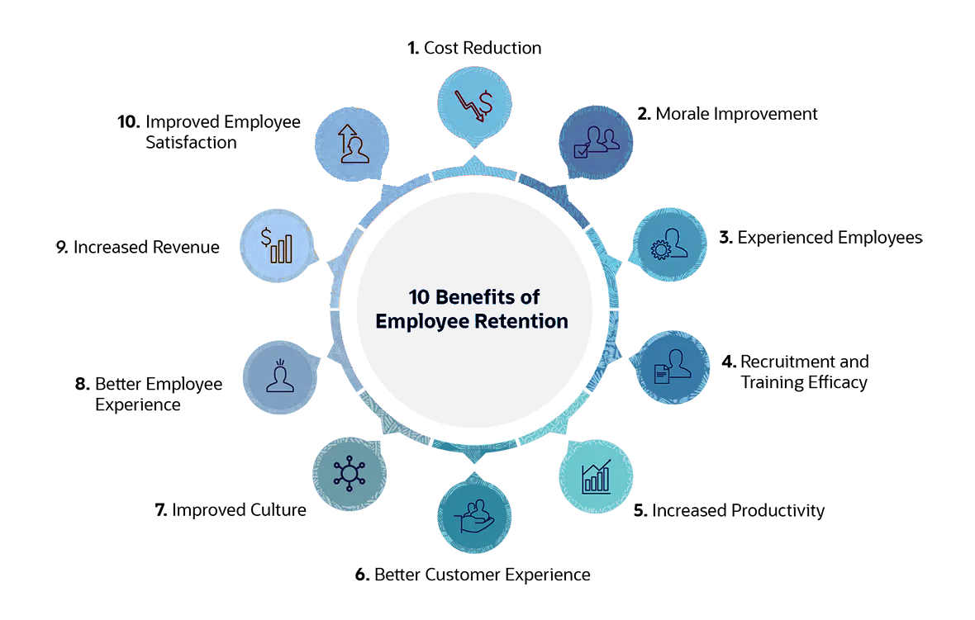
Benefits of Employee Retention
Source: netsuite.com

Slide 7

Deep Dive into the Analysis

Slide 8
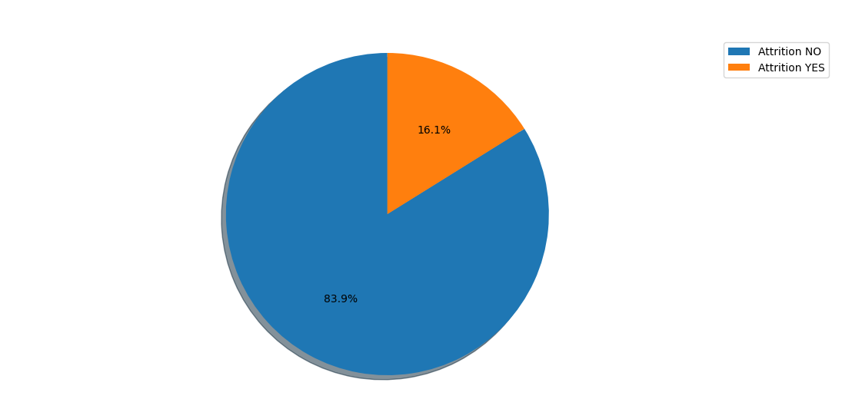
Distribution of Employee Attrition
This pie chart sows that out of 1470 employees :
16.1% of the employees left their job
while other 83.9% of the employees
preferred to stay
Notes:
Susan

Slide 9
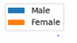
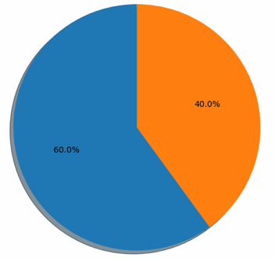
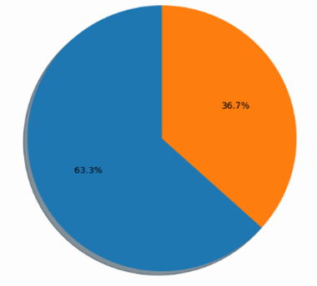
Distribution of Employee based on Gender
The Pie charts depict the population of the data into groups of male and female, we can see that the total employee attrition rate based on sex ratio is:
60 % Male
40 % Female
For the employees who left the ratio is:
63.3 % Male
36.7 % Female
Total Employees
Employees who left
Notes:
Susan

Slide 10
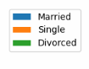
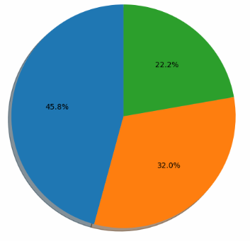
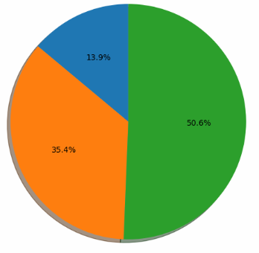
Distribution of Employee by Marital Status
The Pie charts depict the martial status of all the employees in the company
From the employees who left, their martial status was:
50% Divorced
35.4% Single
13.9% Married
Total Employees
Employees who left
Notes:
Susan
Single employees have the highest rate of attrition in the Marital Status category. At the end of the spectrum, a divorced employee will most likely stay at a job. The pie chart also points out, the Married employee will also likely engage in attrition more than a divorced employee but less frequently than the Single employee. From the above pie chart we can see the attrition rate based on Marital status of employees, 50% of divorced employees are more likely to leave as against 13.9% married employees & 35.4% of single employees contribute to the attrition

Slide 11
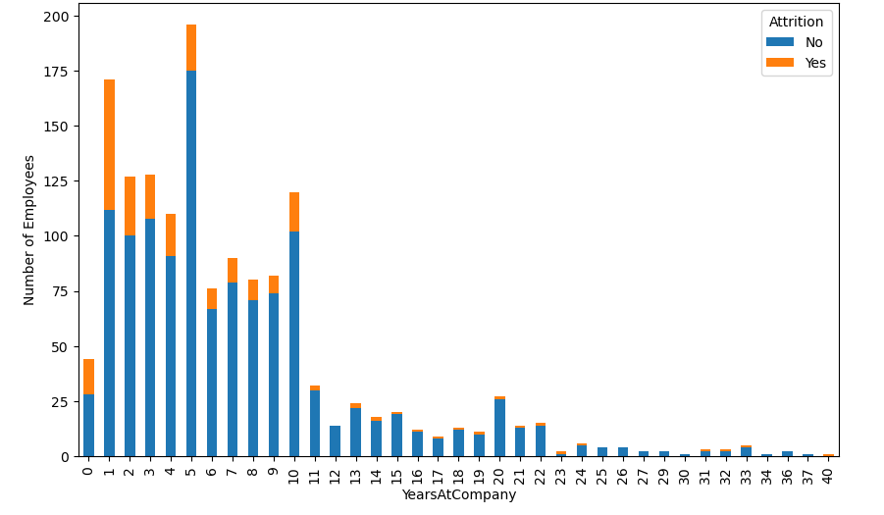
Total of Years at the company
This Bar graph shows that most of the employees that quit, did it within the first 5 years of employment.
Attrition being the highest in the first year of employment.
After 10 years, people are more likely to stay in their current company.
Notes:
Jeffrey

Slide 12
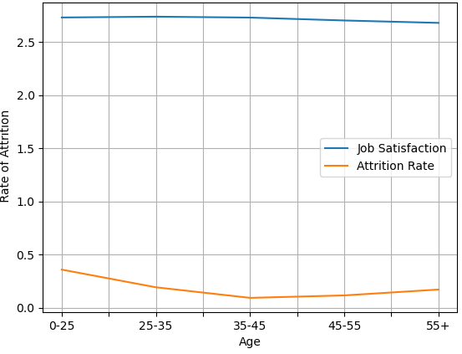
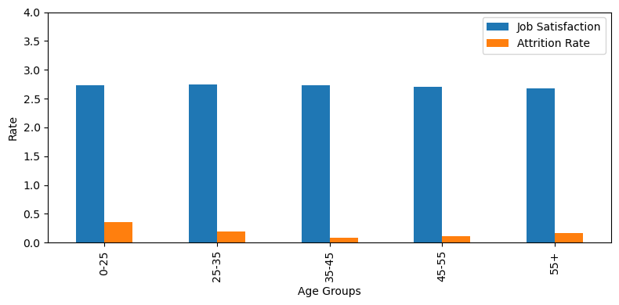
Attrition Rate vs Job Satisfaction
These graphs of Attrition by Job Satisfaction mainly visualizes that the employee attrition rate stabilizes # between ages 35 to 45
Notes:
Jeffrey
# This graph of Attrition by Job Satisfaction mainly visualizes that the employee attrition rate stabilizes # between ages 35 to 45. It also depicts employees’ who are 0 through 45 years old tend to answer job # satisfaction questions about the same. The line for this age group lingers around 2.73 to 2.74. # Its not till age 45 and over does job satisfaction rate show a lower trend. # My conclusion, the Attrition rate is not supported by the Job Satisfaction survey questions. Job satisfaction survey questions does not # assist when determining when an employee will leave your company.

Slide 13
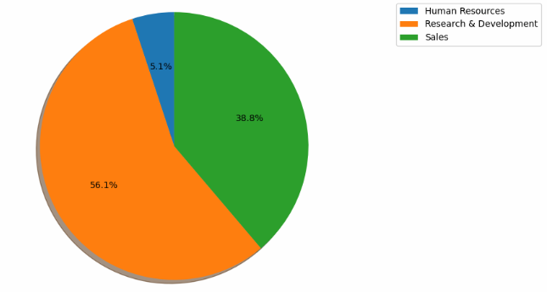
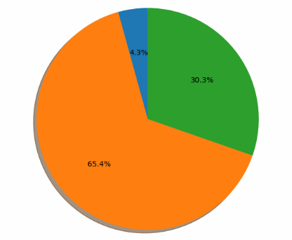
Attrition rate by Department
The Pie charts depict the division of employees by department in the company
From the employees who left:
56.1% are from Research & development
As against 38.8% from Sales
& least number that left are Human recourses, only 5.1%
Total Employees
Employees who left
Notes:
Jeffrey

Slide 14
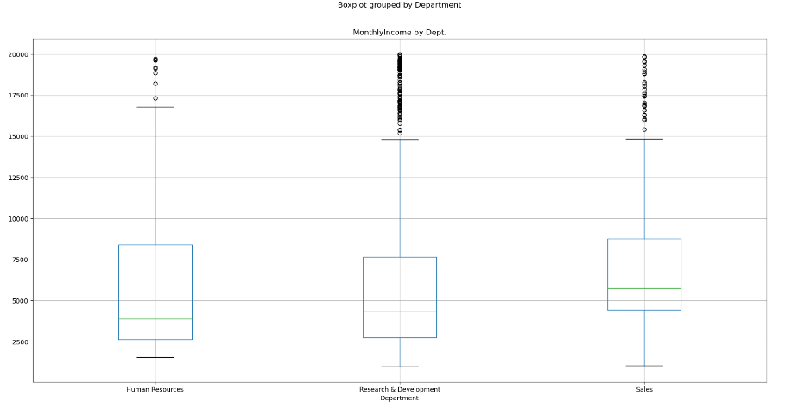
Monthly income by Department
Notes:
Jeffrey
Here we can see the Research & development has the most outliers in terms of monthly income as against Human recourses that has the least outliers Research & Development is also the dept. with highest attrition & Human resources the least attrition, it can be concluded that irregularity in pay scales within the dept. is contributing to the high attrition
solution could be to equalize pay scales of employees within the dept.
The lower quartile of Monthly Income is: 2911.0
The upper quartile of Monthly Income is: 8379.0
The interquartile range of Monthly Income is: 5468.0
The median of Monthly Income is: 4919.0
Values below -5291.0 could be outliers.
Values above 16581.0 could be outliers.

Slide 15
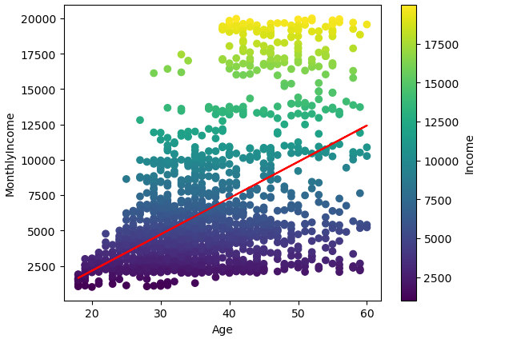
Correlation and Regression: Age vs Monthly Income
The heatmap shows that the older employees tend to make higher income.
This is another instance where younger employees are shown to have lower income.
Notes:
Brandon

Slide 16
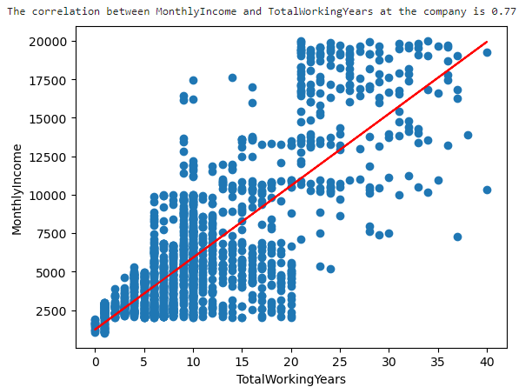
Correlation and Regression: Monthly Income vs Total Working Years
Total Employees:
This chart displays how the total years of service is correlated with salary growth.
Notes:
Brandon

Slide 17
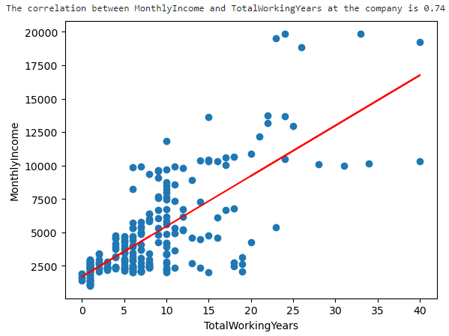
Correlation and Regression: Monthly Income vs Total Working Years
People who left:
Employee attrition happens mostly at lower incomes and early into employees’ careers
Notes:
Brandon

Slide 18
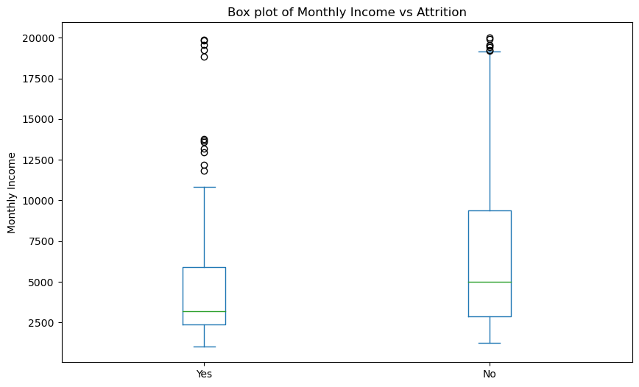
Attrition vs Income
Employees who left their jobs tend to have lower monthly incomes than those who stayed
Notes:
Vigneshwar

Slide 19

Conclusion
The people leaving the company are mostly young, single and in the beginning of their carriers
Research & Development suffers disproportionately more attrition than other departments
Generally, people that are lower on the pay scale are more likely to leave.
Notes:
Vigneshwar

Slide 20
Questions
Notes:
Everyone

Slide 21
Group II
JEFFREY Cruz-GARCIA
Olesya Gaeva
Aditi garg
BRANDON chacon-MATA
SUSAN ESPINOSA
VIGNESHWAR CHERIATH
THANK YOU

